Slide 1
RICE LEAF DISEASE PREDICTION USING CNN
CB.EN.U4EEE22041 CB.EN.U4EEE22062 CB.EN.U4EEE22064 CB.EN.U4EEE22066

Slide 2
CONTENT:
INTRODUCTION
OBJECTIVE
METHODOLOGY
BLOCK DIAGRAM
RESULTS
CONCLUSION

Slide 3
INTRODUCTION:
Rice, a staple crop for over half the world's population, faces significant production losses due to various diseases. Traditional detection methods, like manual inspection, are slow, labor-intensive, and error-prone, highlighting the need for automated solutions to detect diseases early.
Machine learning (ML), especially deep learning models like Convolutional Neural Networks (CNNs), enables accurate disease classification through image analysis. This study proposes an ML-based system involving data acquisition, preprocessing, feature extraction, and classification to provide real-time crop health insights, helping farmers reduce losses and improve yield quality.

Slide 4
OBJECTIVE:
The objective of this study is to develop an efficient machine learning-based system for detecting and classifying rice leaf diseases. The research aims to automate the identification of major rice diseases, including Leaf Blast, Bacterial Blight, and Brown Spot, using image-based analysis. To achieve this, the study focuses on enhancing image data through preprocessing techniques such as resizing, normalization, and augmentation, ensuring better model performance.
A key aspect of this work is training and evaluating machine learning models, particularly Convolutional Neural Networks (CNNs), to achieve high accuracy in disease classification. Additionally, the study seeks to compare the performance of various models using metrics like accuracy, precision, recall, and F1-score to determine the most effective approach. Finally, the trained model will be deployed as a web or mobile application, enabling real-time disease detection and assisting farmers in making informed decisions. By implementing this system, the study aims to reduce crop losses, improve rice yield quality, and contribute to precision agriculture.

Slide 5
METHODOLOGY:
Data Collection & Preprocessing: The dataset consists of 120 images of diseased rice leaves. Images are resized, normalized, and augmented to improve model performance.
Data Loading: The dataset is imported into a TensorFlow dataset object, ensuring efficient data handling during training. The images and corresponding labels are loaded into a structured format suitable for deep learning models.
Model Selection & Training: A Convolutional Neural Network (CNN) is used for feature extraction and classification. The model is compiled with categorical cross-entropy loss and trained using the Adam optimizer.
Model Evaluation: The trained model is assessed using accuracy, precision, recall, F1-score, and a confusion matrix to ensure effective classification.
Deployment: The final model can be deployed as a web or mobile application for real-time disease detection.

Slide 6
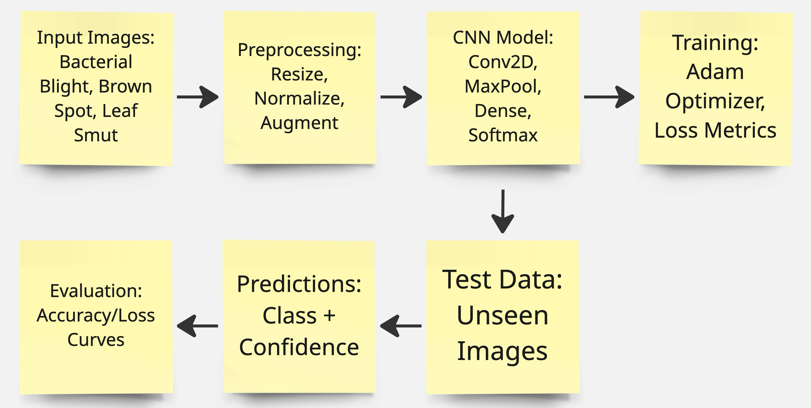
BLOCK DIAGRAM:

Slide 7
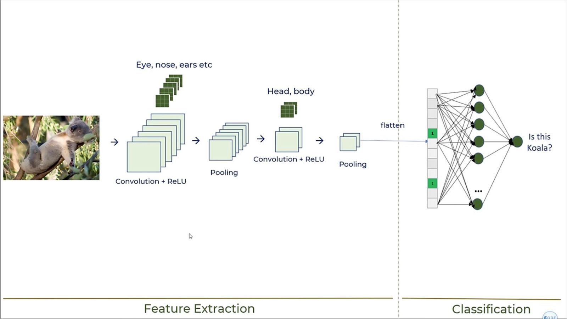
CNN Model

Slide 8
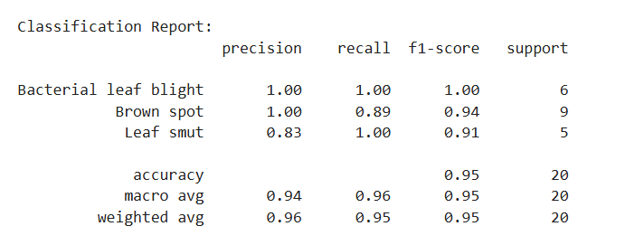
RESULTS:

Slide 9
CONCLUSION:
Rice leaf diseases pose a significant threat to global rice production, affecting crop yield and food security. Traditional disease detection methods are often time-consuming, subjective, and prone to human error, making early identification and management challenging. In this study, a machine learning-based approach has been proposed for the automated detection and classification of rice leaf diseases, focusing on Bacterial Leaf Blight, Brown Spot, and Leaf Smut. By utilizing image preprocessing techniques, deep learning models, and performance evaluation metrics, the system aims to provide an accurate and efficient disease classification solution.
The expected outcomes of this research include the development of a robust CNN-based model capable of classifying diseases with high accuracy. Furthermore, the deployment of this model as a web or mobile application will enable farmers to quickly identify diseases and take necessary preventive actions. By integrating artificial intelligence into precision agriculture, this system can help minimize crop losses, reduce excessive pesticide use, and improve overall rice productivity.

